Slide 1
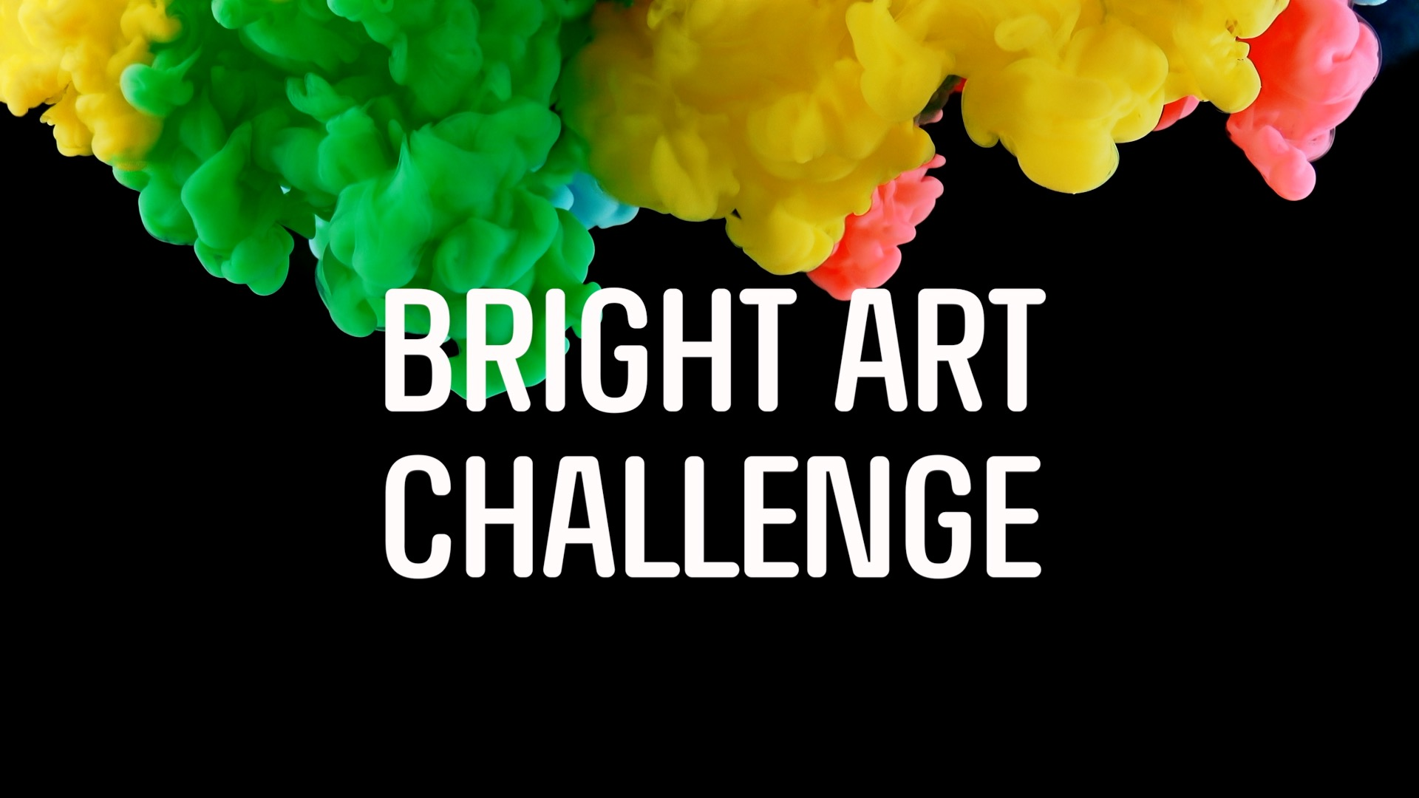

Slide 3
Welcome to the Future Engineers Bright Art Challenge! During this STEAM journey, dive into the electromagnetic spectrum, properties of visible light, light interactions and create art with purpose. We can’t wait to see your masterpiece!!
Be brilliant…and good luck!

Slide 4
The Challenge
Your challenge is to create a piece of art using a battery-powered LED light source that demonstrates at least two interactions with light.

Slide 5
The Challenge
You can use materials that may include recyclables, trash, borrowed objects (each of which is no more than $10), and items found in nature.

Slide 6
The Challenge
Your submission must include a video demonstration (max 30 seconds) that shows off your and a text description of your design and its light interactions. Be sure to review the CONTEST RULES and DESIGN GUIDELINES for all challenge details.

Slide 7
ARE YOU UP FOR THE CHALLENGE? Submit By May 29, 2019

